Slide 1


The 2024 Change Healthcare Cyberattack and the Imperative of Multi-Factor Authentication
This presentation examines the 2024 Change Healthcare cyberattack, highlighting the critical role of Multi-Factor Authentication (MFA) in preventing such breaches. We will explore the attack's technical and organizational weaknesses, evaluate popular MFA solutions, and propose an optimal choice for enhanced access security.
Presented By:
Namrata Mali
Ayush Kumar Gupta
Sai Mani Ritish

Slide 2
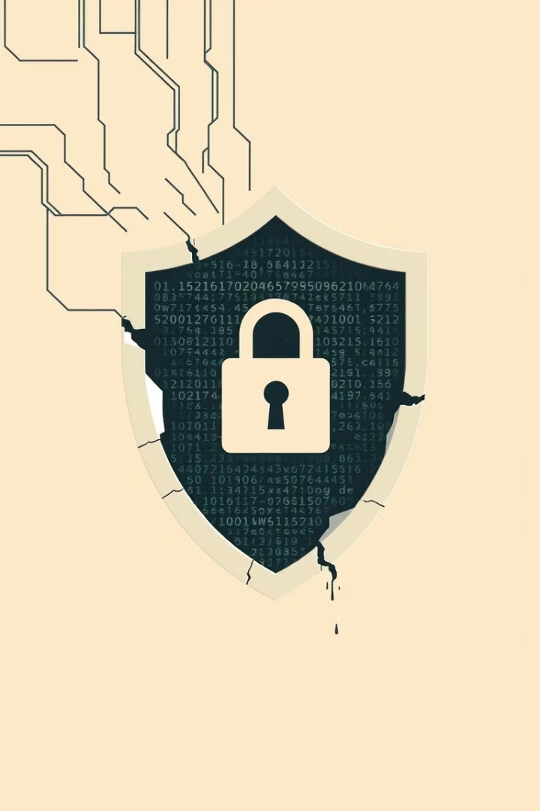



Overview of the Change Healthcare Cyberattack
Incident Summary
Operational Disruption
On February 21, 2024, Change Healthcare discovered a ransomware assault via a Citrix remote access portal lacking MFA. Cybercriminals infiltrated the system, deployed ransomware, and extracted data from February 17-20, 2024.
The attack interrupted electronic payments and medical claims processing nationwide, causing significant delays in patient care and financial strain on providers.
Data Breach & Financial Impact
Personal details of around 100 million people were breached. UnitedHealth Group confirmed ALPHV/BlackCat was responsible and paid a $22 million ransom, incurring substantial financial losses.

Slide 3
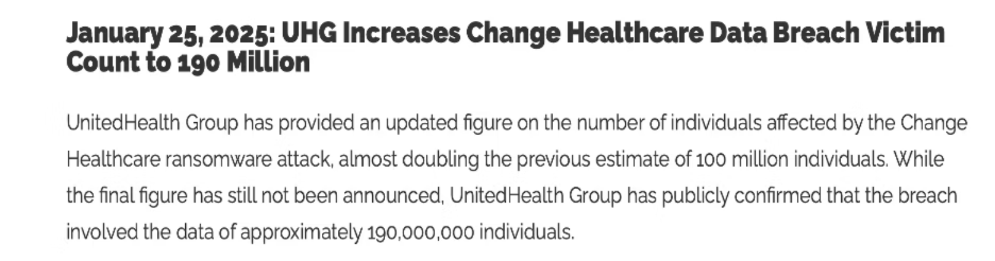
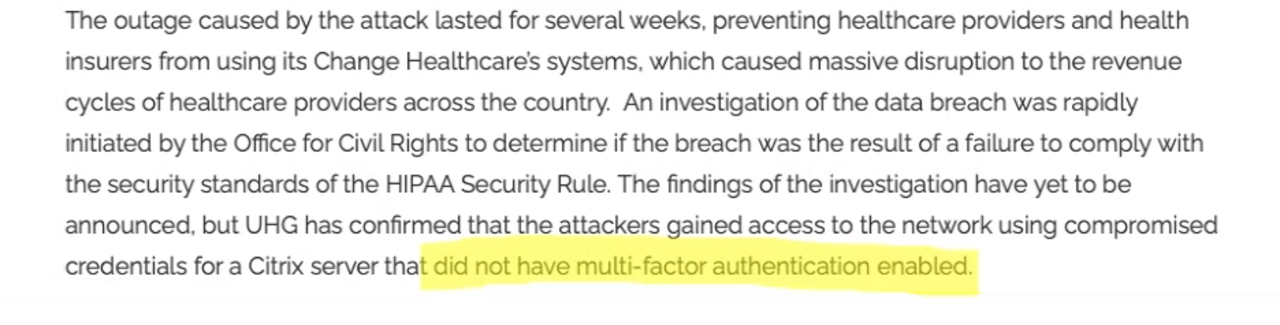

Slide 4
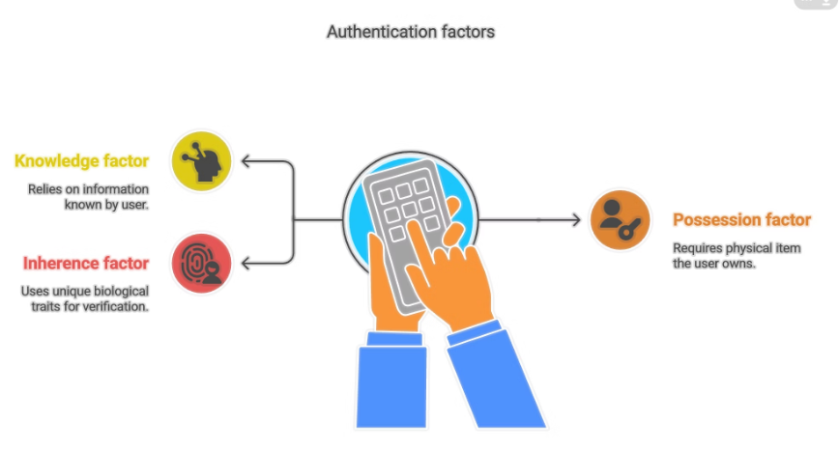
Multi-Factor Authentication (MFA): A Critical Security Measure
What is MFA?
Authentication Elements
MFA enhances security by requiring users to provide two or more verification elements to access a system. This significantly lowers the chances of unauthorized access, even if one credential is breached.
Something you know: Password or PIN
Something you have: Security token or mobile device
Something you are: Biometric authentication (fingerprints, facial recognition)

Slide 5

MFA System Selection Criteria
Popularity and Usage
Systems commonly utilized in educational organizations and companies were prioritized for evaluation.
Variety of Technology
Platforms offering diverse authentication options, including push notification, biometric, TOTP, and SMS, were considered.
Accessibility
Systems readily accessible to users without needing specialized equipment were a key factor.
Security Track Record
Only systems with proven robust security and industry credibility were selected for analysis.

Slide 6

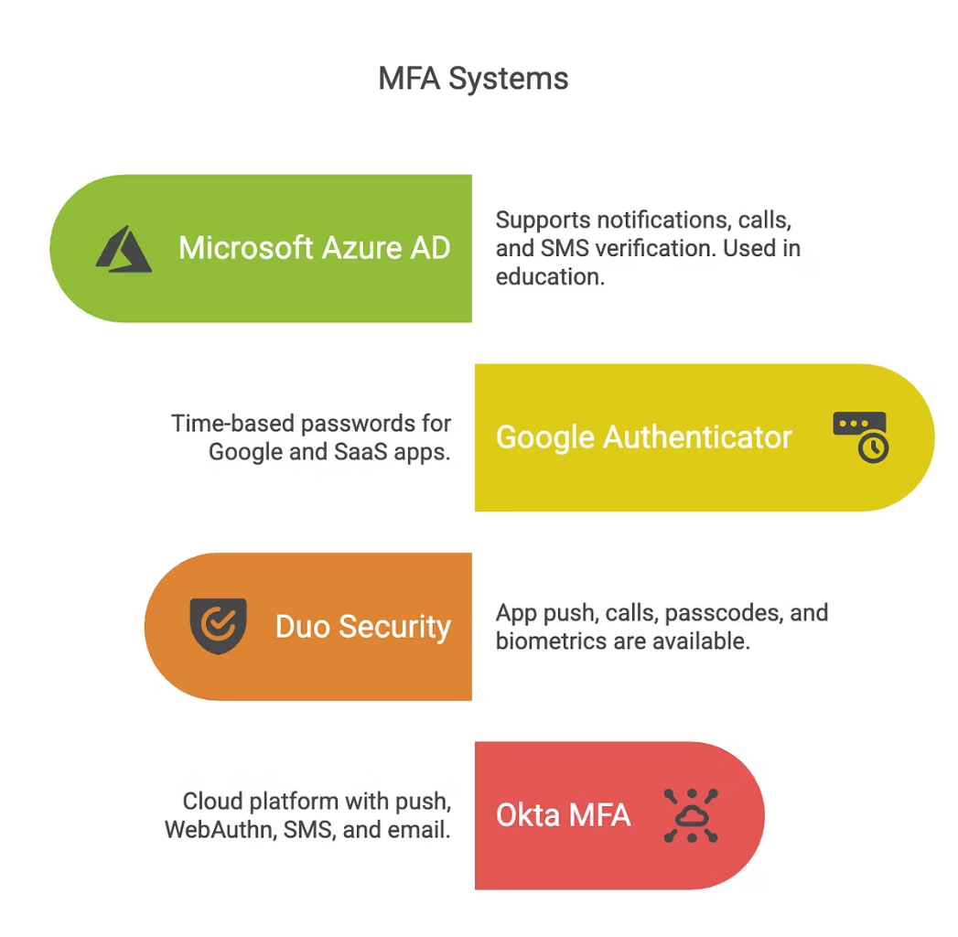
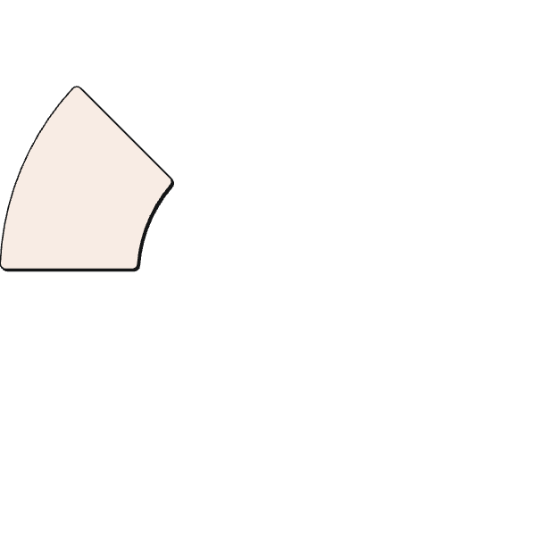

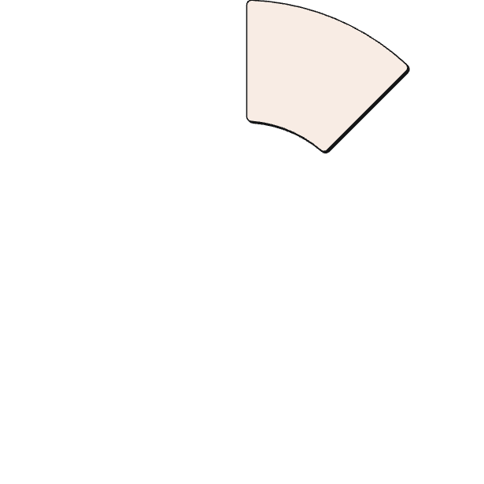
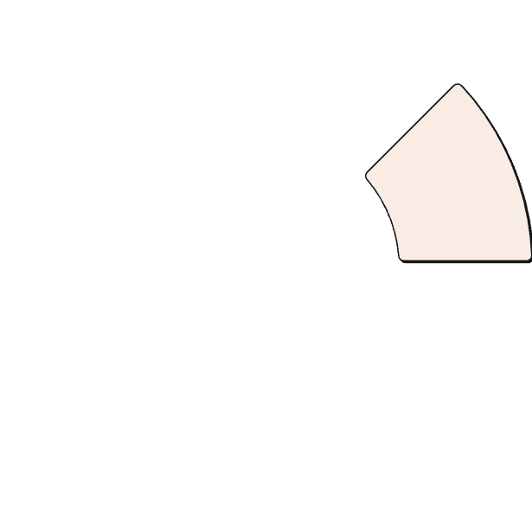




Popular MFA Systems and Functionality
Google Authenticator
Duo Security (by Cisco)
Microsoft Azure AD MFA
Time-based One-Time Password (TOTP) system. Widely used by Google accounts and many SaaS apps.
Offers app push, phone call, passcode, and biometric options. Used in universities and enterprises.
Supports mobile app notifications, phone calls, and SMS. Used in educational institutions like CityU.
Okta MFA
Cloud-based identity platform supporting app push, WebAuthn, SMS, and email verification.

Slide 7

Use Cases for MFA Implementation
Register Account
User submits username/password, system displays QR code for MFA setup, user scans QR code with Google Authenticator.
1
2
Login Process
User enters username/password, system prompts for 6-digit OTP, user retrieves OTP from Google Authenticator, submits it, and system verifies for access.

Slide 8
Comparison & Preferred System
Azure AD MFA
Push, SMS, Call
High
High
Google Authenticator
TOTP only
Medium
Moderate
Duo Security
Push, Call, Biometric
High
Very High
Okta MFA
Push, WebAuthn, Email, SMS
High
Very High
While Duo Security and Okta MFA offer robust enterprise features, Google Authenticator stands out for its simplicity, offline functionality, and cost-effectiveness, making it ideal for organizations seeking swift security enhancements without significant burden.

Slide 9
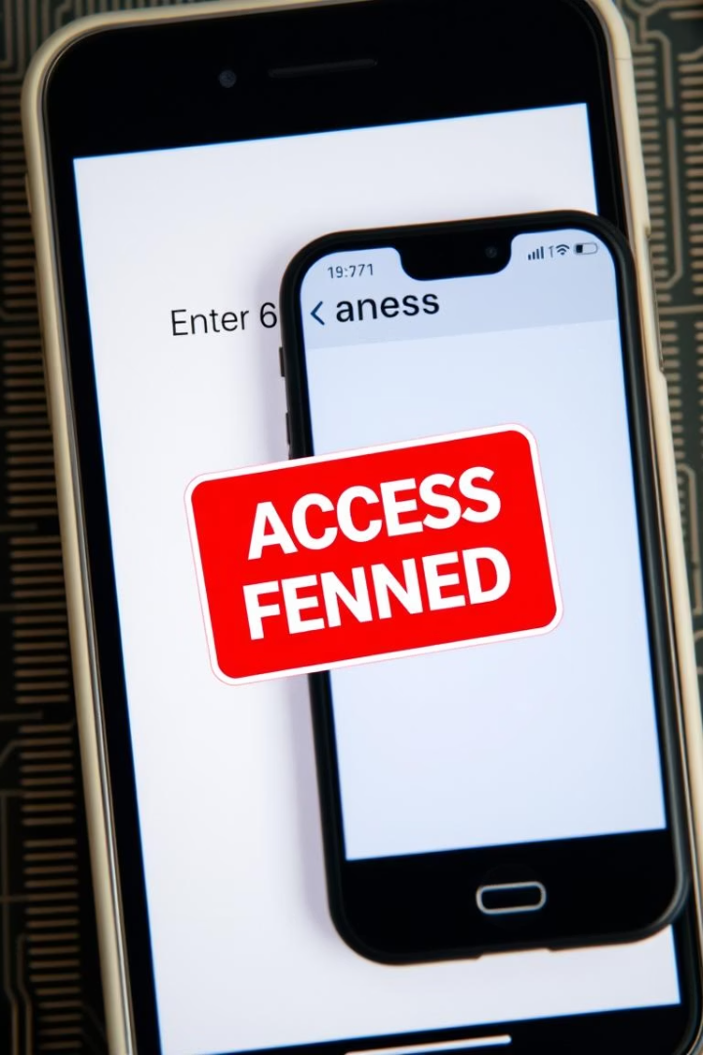
Mock Situation: Google Authenticator in the Change Healthcare Cyber Incident
Compromised Credentials
Intruders used stolen username and password to access the Citrix portal, which lacked MFA.
MFA Request
If Google Authenticator was active, the system would request a 6-digit TOTP from the legitimate user's device.
Access Denied
Without physical access to the device and secret key, the attacker couldn't generate the code, halting the attack.

Slide 10



Conclusion and Key Takeaways
Enhanced Security
Even simple MFA applications significantly boost system protection against cyber threats.
1
Google Authenticator
2
Ideal for SMBs, offering strong TOTP security, offline functionality, ease of use, and affordability.
MFA is Essential
3
No longer optional, MFA is a vital protection for organizations managing sensitive data in a hostile cybersecurity environment.

Slide 11
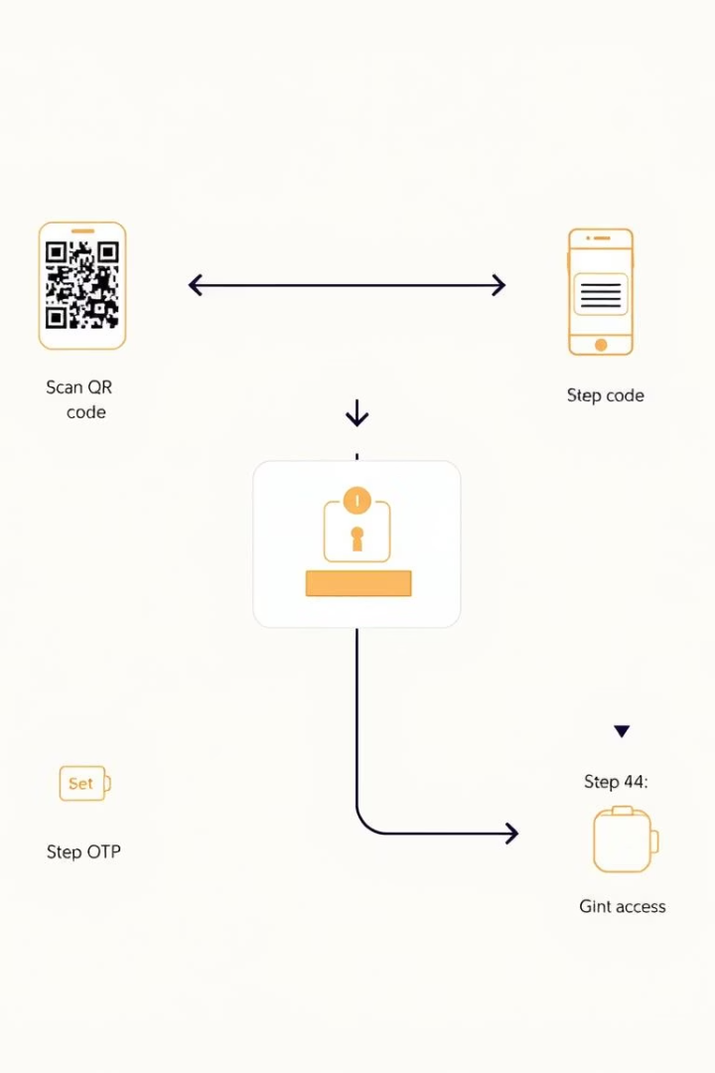



Project Description: MFA Prototype
Backend Development
Created using Flask and MongoDB to manage user registration, QR code creation, and OTP verification.
Frontend Interface
A React-based interface guides users through account setup, QR scanning, OTP submission, and confirmation.
Technical Responsibilities
Included implementing CORS, creating user-friendly interfaces, managing error scenarios, and ensuring accurate OTP time window validation.

Slide 12
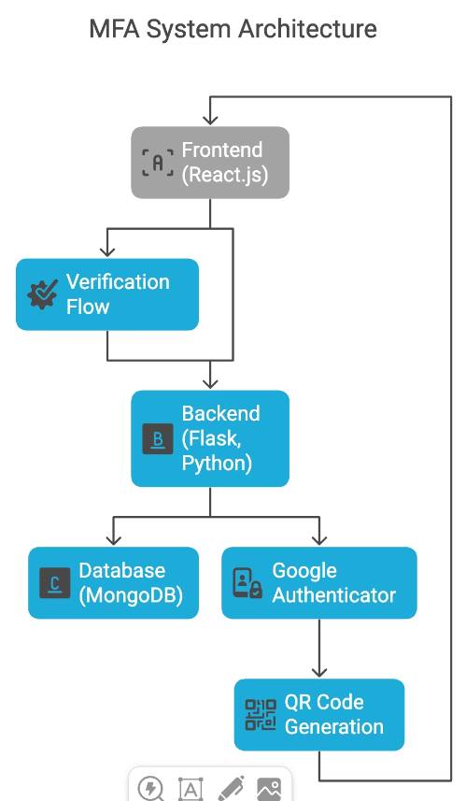
ARCHITECTURE
Frontend (React.js): Provides the user interface for registration, login, QR code display, and OTP entry.
Backend (Flask, Python): Handles API routes for registration, login, OTP verification, and communicates with the database.
Database (MongoDB): Stores user records, including email, hashed password, and MFA secret key for TOTP.
Google Authenticator (Mobile App): Generates time-based one-time passwords (TOTP) linked to the backend’s issued secret.
5. QR Code Generation: Backend generates a provisioning URI encoded as a QR code for easy scanning by Google Authenticator.
6. Verification Flow: Frontend collects user OTP, backend verifies it against the stored secret and grants or denies access.

Slide 13

DEMO

Slide 14
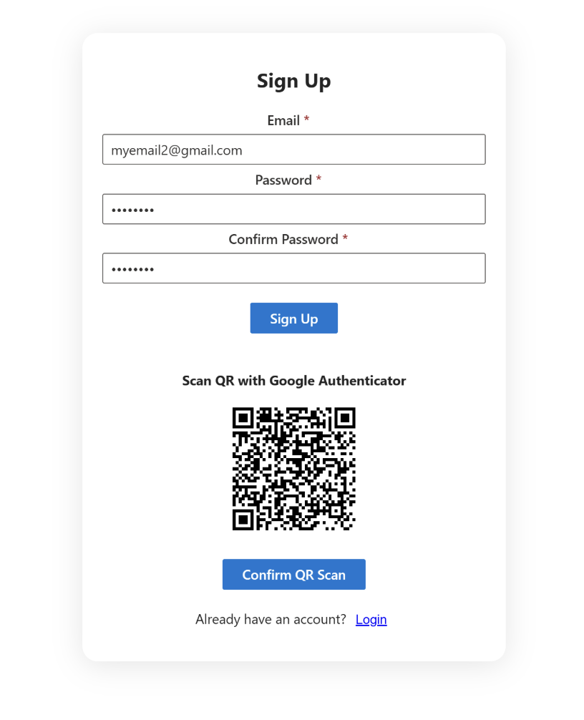
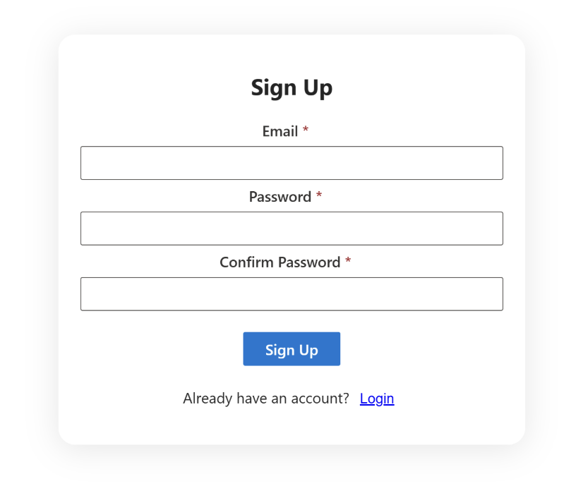
UI IMAGES

Slide 15
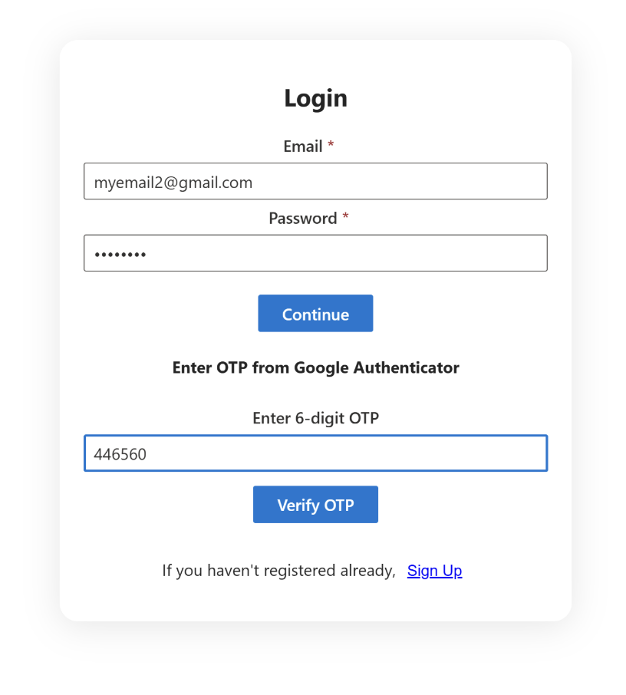
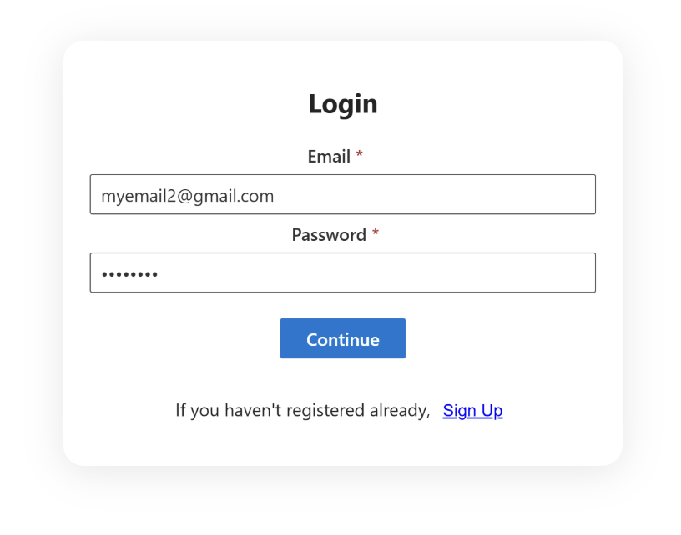
UI IMAGES

Slide 16
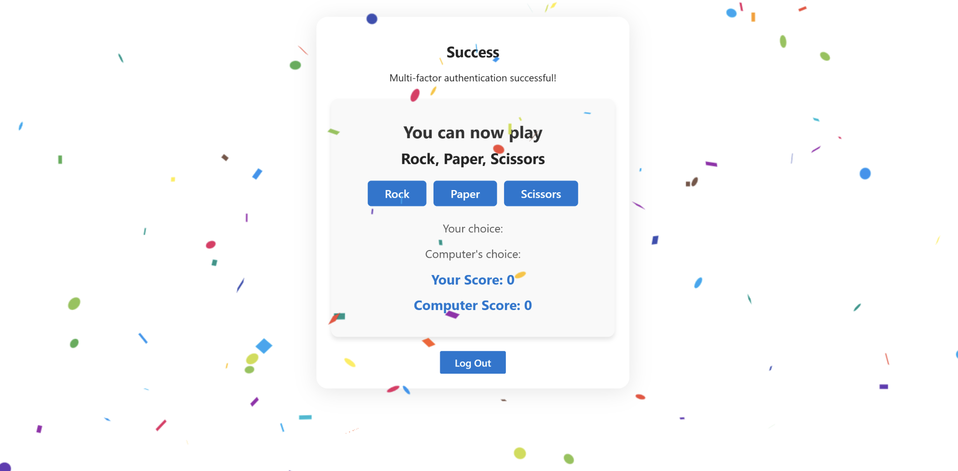
UI IMAGES

Slide 17

Q & A

